Slide 1
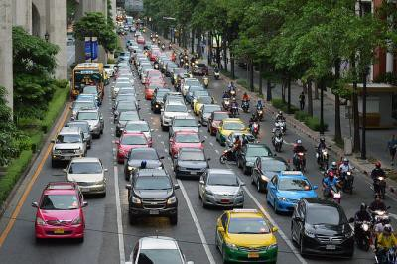
Lesson 7: Driving & Directions
Conversation #1 – Driving
Elizabeth: Hey Jonas! How was your road trip to Chicago?
(road trip = a long trip by car)
Jonas: It was a nightmare – one disaster after another.
Elizabeth: Huh? What on earth happened?
Jonas: Well, I offered to give my girlfriend’s brother a ride to Philadelphia. It was a bit out of our way – but that wasn’t the problem. The problem was that he’s a super- annoying backseat driver.
(out of our way = in a different direction from our planned destination / path)
Elizabeth: Really?
Jonas: Yeah, like – getting on my case for forgetting to use my turn signal before merging, or telling me that I should get out of the exit-only lane – on and on for about four hours.
(on and on = continuing)
Elizabeth: My mom is like that. I mean, it’s OK that she reminds me to buckle up, but I wish she wouldn’t scream “SLOW DOWN!” every time I go a tiny bit over the speed limit.
Jonas: Exactly. So after we dropped him off in Philly, we got stuck in a major traffic jam for over an hour before I finally managed to get off the highway and take a different road. But then there was a detour due to roadwork, and we got lost for another three hours.

Slide 2
Elizabeth: Wow, that’s nuts! Was it pretty smooth sailing after that?
Jonas: No, it gets worse. We made a pit stop outside of Cleveland, and I was in such a rush to use the bathroom that I locked my keys in the car.
(make a pit stop = stop driving to use the bathroom or to get food/drink)
Elizabeth: Oh no!
Jonas: After shelling out $50 for a locksmith, we were back on the road – but then the engine started overheating and I had to pull over.
(shelling out = paying money that you don’t want to pay)
Elizabeth: I think I would’ve given up if I were you!
Jonas: Yeah, but we were already over halfway there by that point, so I was determined to keep going. Just as we were getting to Chicago, another driver cut me off and I had to slam on the brakes to avoid crashing into him.
Elizabeth: Geez. I didn’t know Chicago drivers were so aggressive.
Jonas: Unfortunately, the woman behind me was talking on her cell phone and when I stopped suddenly, she rear-ended me.
Elizabeth: No way! Was your car badly damaged?
Jonas: Nah, it was just a fender-bender. My insurance will cover the repairs. But the whole trip was really stressful – next time, I’m just booking a flight!
(fender-bender = a very minor accident)
Conversation Vocabulary & Phrases
In the beginning of the conversation, Jonas offers to give his girlfriend's brother a ride - that means take him in the car. If you want to offer someone a ride, you can use these phrases:
"Do you need a ride / lift?"
"I'll pick you up at..."
(pick someone up = take the person in your car)

Slide 3
"I can drop you off at..."
(drop someone off = when the person leaves your car)
Unfortunately, the brother is a backseat driver – that’s a person in the car who is not driving, but who criticizes the driver’s abilities or who makes lots of suggestions and gives lots of tips for the driver to improve.
Some of the comments a backseat driver might make:
"You don't want to be in this lane - it's exit-only."
(roads are divided into lanes. An exit-only lane is one where the only option is to leave the highway)
"You forgot to use your turn signal / blinker before merging."
(turn signal / blinker = the yellow or orange light on the sides of a car, used to indicate the direction you plan to go. Merge = move from one lane into another)
"Slow down - the speed limit is 55."
(speed limit = the maximum velocity.
Slow down = drive slower. Speed up = drive faster)
"You missed your turn."
(you accidentally went past the place where you were supposed to turn right/left)
"Stop tailgating - it's not safe."
(tailgating = follow the car in front of you very closely)
"Everybody buckle up."
(buckle up = put on your seatbelt)
"It's getting dark - you should turn on your headlights."
(headlights = the lights on the front of the car)
During the conversation, a number of driving problems are mentioned:
"I got stuck in a traffic jam."
(traffic jam = when the traffic is stopped or slow)
"There was a detour due to roadwork."
(detour = an alternate route)
(roadwork = maintenance or repairs on the road)
"I got lost."

Slide 4
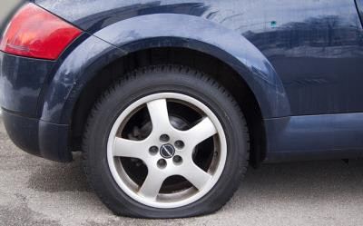
"I locked my keys in the car."
"The engine started overheating and I had to pull over."
(overheating = getting too hot)
(pull over = drive the car to the side of the road and stop)
"I got a flat tire."
(flat tire = when the tire loses its air)
"The car broke down."
(broke down = had a mechanical problem and stopped functioning)
"Another car cut me off."
(cut me off = another car drove in front of my car very suddenly)
"Another car rear-ended me."
(rear-ended = hit/crashed into the back of my car)
Conversation #2 – Asking for Directions
Tiffany is going to see a baseball game at Yankee Stadium – but she gets lost on the way, so she stops to ask for directions.
Tiffany: Excuse me. How can I get to Yankee Stadium from here?
Man: You have to get on the highway, but you already passed the onramp. So turn around and go back the way you came, and just follow the signs for I-95 South. Go about 5 miles on I-95 and get off at exit 2A.
(onramp = the access road where you can enter the highway)
Tiffany: Could you show me on the map?
Man: Sure. You’re here, and the highway is here. Exit 2A is here.

Slide 5
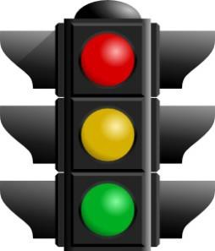
Tiffany: Thanks a lot.
(later, she gets off exit 2A, but doesn’t see any signs for the stadium)
Tiffany: Could you tell me how to get to Yankee Stadium?
Man: Yes, go past the gas station and turn left at the first light – that’s Walton Avenue. Go straight down Walton until you hit East 164th Street, and then…
Tiffany: Just a minute – let me write this down.
Man: OK. Take Walton to East 164th Street and turn right. If you see the mall, you’ve gone too far. After you’re on 164th then take your second left onto River Avenue – your best bet for parking is at the corner of River and 162nd Street.
Tiffany: Sorry, could you repeat the part about River Avenue?
Man: From 164th Street, you turn left onto River Avenue and just keep going until you see the parking lot. It’s about four blocks and it’ll be on your left, across from a hotel. Did you get all that?
Tiffany: I think so. Thanks.
Conversation Vocabulary & Phrases
To ask for directions, you can start with “Excuse me,” and then use these phrases:
“How can I get to… the Museum of Modern Art?”
“Could you tell me how to get to… Grand Street?”
“Where is… the nearest hospital?”

Slide 6
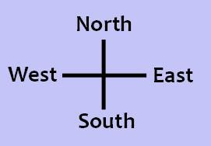
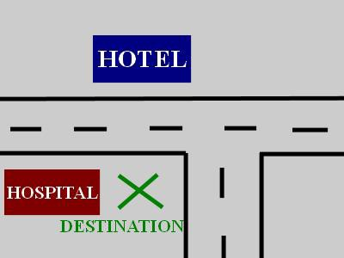
Directions are often given with these verbs:
go + direction
“Go right / left / straight / east / west / north / south.”
go + distance
“Go three blocks down this street, then turn left.” “Go five miles on Route 25W, then take exit 16.”
turn + right/left/around
take the second/third right/left
take + road name / public transportation
“Take Route 81.”
“Take Main Street north for about three miles.”
“Take the 3 train, then transfer to the F train at Fulton Street.” “Take the bus towards Chinatown.”
stay on + road (continue on the same street)
“Stay on this road for about five miles.”
“Stay on the highway for another ten minutes.”
When giving directions, it’s helpful to use landmarks – obvious reference points. For example:
“Go past the big white church.”
“When you get to the clock tower, turn left.”
“If you see a shopping mall, you’ve gone too far.”
“Turn right at the next light.”
(light = traffic light)
The destination will be…
on your left / on your right
across from… (a hotel)
next to… (the hospital)
on the corner
You’ve finished Lesson 7! Now take the quiz to test your memory of the phrases from this lesson.

Slide 7
If you’re ready for a speaking challenge, click here to leave me a message giving directions from your house to a destination you typically go (work, school, the supermarket, etc.)
Quiz – Lesson 7
After I'm on the highway, what do I take?
block B. onramp C. exit
Just a moment - let me write this .
off B. up C. down
Should I left or right at the light?
follow B. pass C. turn
How can I to the National Theater?
arrive B. travel C. get
Can you me on the map?
show B. find C. see
on the highway for another fifteen miles, then take exit 12.
keep B. stay C. take
If you see the university, then you've gone too and you'll need to turn around.
far B. long C. much
Thanks for offering me a ride. Can you me up in about twenty minutes?
get B. pick C. take
Driving fast when it's raining is dangerous - you should down.
buckle B. slow C. speed
Excuse me, where is the gas station?
longest B. farthest C. nearest

Slide 8
The first time I drove in Philadelphia, I got and had to stop and ask for directions.
lost B. missed C. jammed
Don't take the highway - they're doing some and two lanes are closed.
detour B. merging C. roadwork
Sorry I'm late - I got a tire and I had to call a friend to help me change it.
broken B. cut C. flat
I dropped my sister at school on my way to work.
off B. out C. up
She's so forgetful, she her keys in the car at least once a week.
locks B. misses C. shuts

Slide 9
Lesson 7 Quiz - Answers
1.C 2.C 3.C 4.C 5.A 6.B 7.A 8.B 9.B 10.C 11.A 12.C 13.C 14.A 15.A

